Slide 1
n8n Advanced AI Workflow
2026 Fall
조상구교수

Slide 2

n8n n8n Advanced Course
n8n Basic Course
2026 Fall
조상구교수

Slide 3
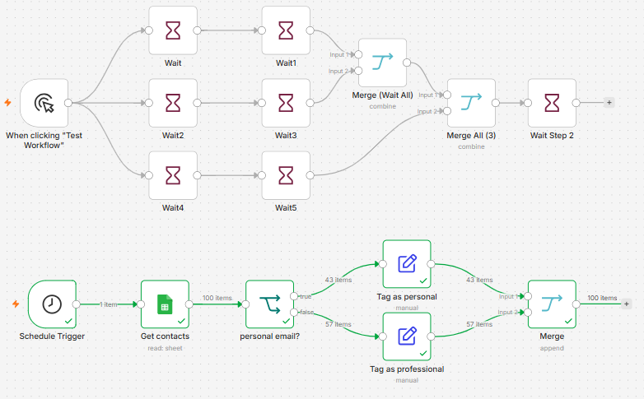
3
Working with complex data flows
1_Working with complex data flows.json

Slide 4

n8n Advanced Tutorials
2026 Fall
조상구교수

Slide 5

n8n Advanced Tutorials
2026 Fall
조상구교수

Slide 6

n8n Advanced Tutorials
2026 Fall
조상구교수

Slide 7

n8n Homework
2026 Fall
조상구교수

